Slide 1
Group 6- Order Fulfillment
Alex Comerford
Divya Raviraj Rao
Harshita Umesh Tanksali
Vedant Dinesh Patil

Slide 2
Order Fulfillment Business Problem
FudgeFlix: This is a database similar to Netflix that is for renting DVD’s.
FudgeMart: This is an online retailer that sells products to customers and vendors.
Problem: Fulfilling “Orders” happens in both of these databases and they need to be merged into one uniform data warehouse to capture the business process of Order Fulfillment.
Notes:
Alex

Slide 3
Goals of the Project
On-time delivery : Ensuring orders are delivered within the ideal time frame. That is KPI value for Lag time <= 3 should be 1, KPI value for 3 < Lag time < 7 is 0 and more than 7 is -1.
Cost Control : Optimizing order fulfillment processes to minimize operational costs. Further explained in Visual.
Better Customer Insights : Visualizing products and customer shopping patterns for more data driven decisions.
Notes:
Alex

Slide 4
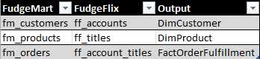
Mapping
Notes:
Alex

Slide 5
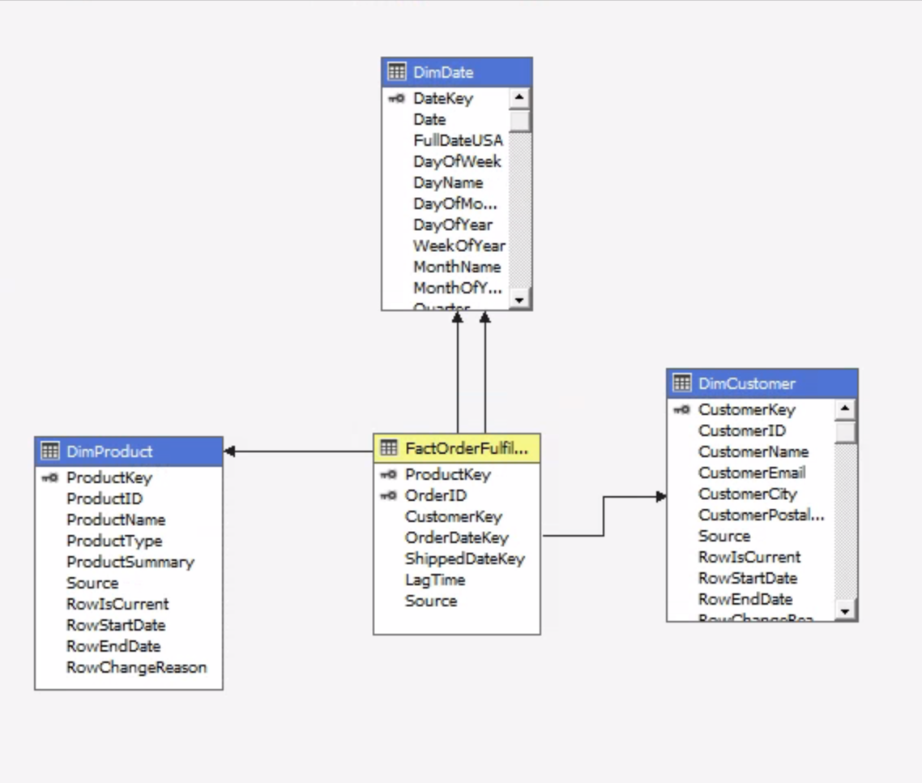
Star Schema
Notes:
Harshita

Slide 6
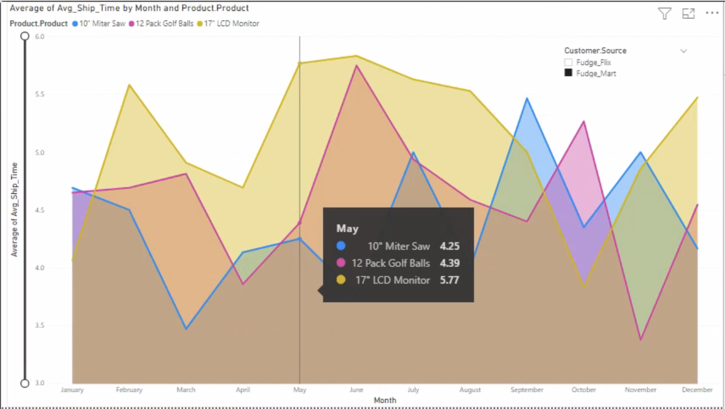
Analytics
Notes:
Harshita

Slide 7
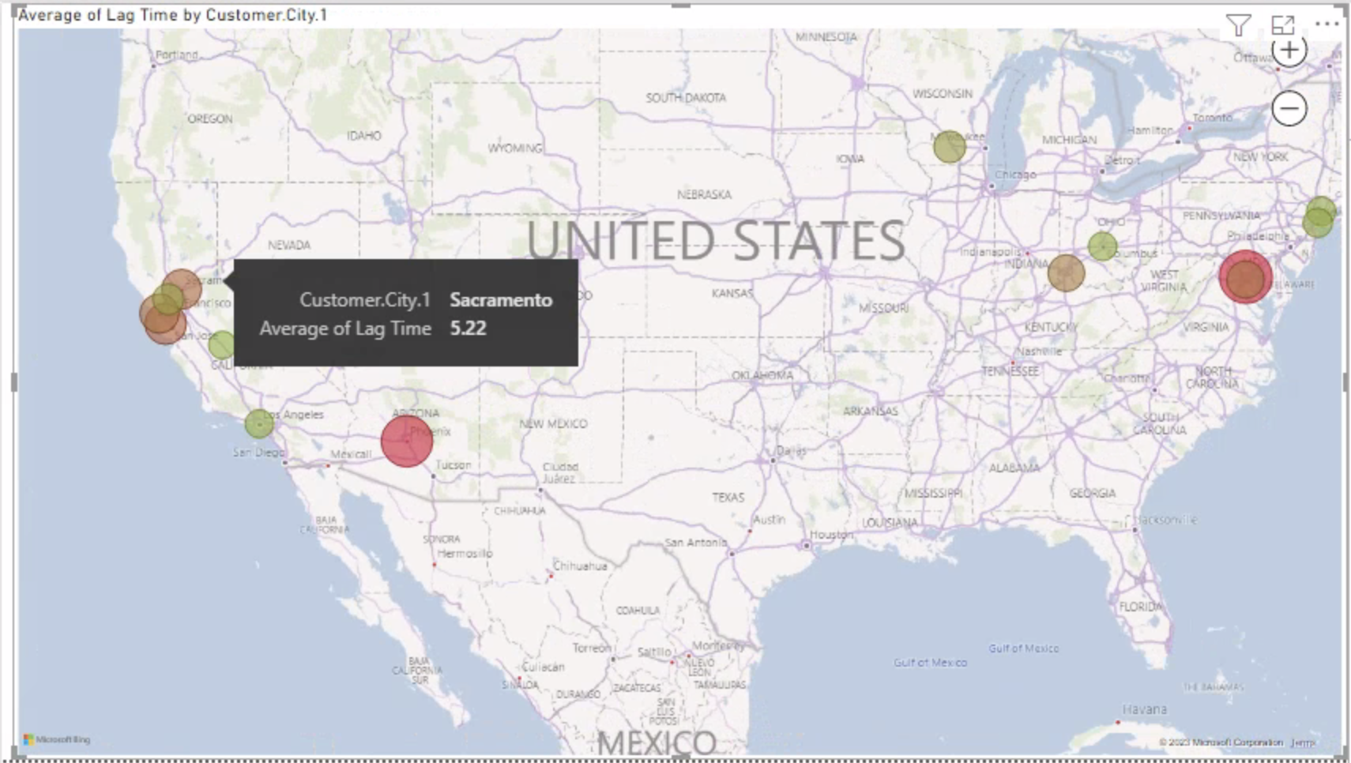
Notes:
Harshita

Slide 8
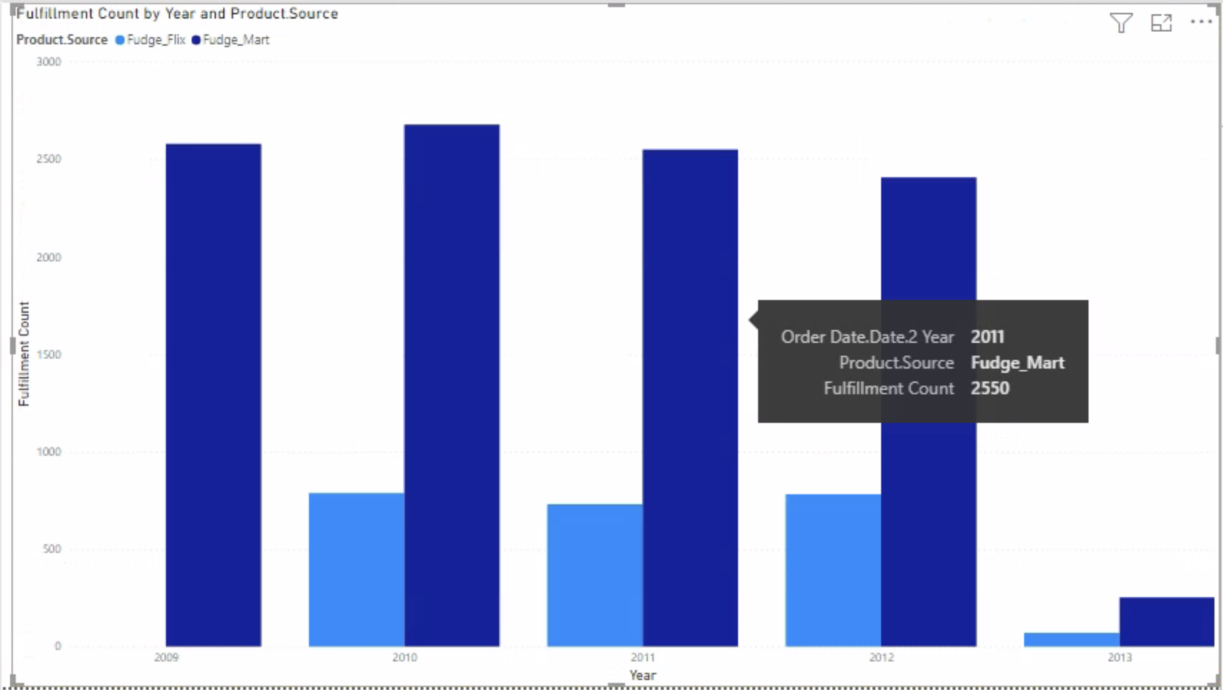
Notes:
Divya

Slide 9
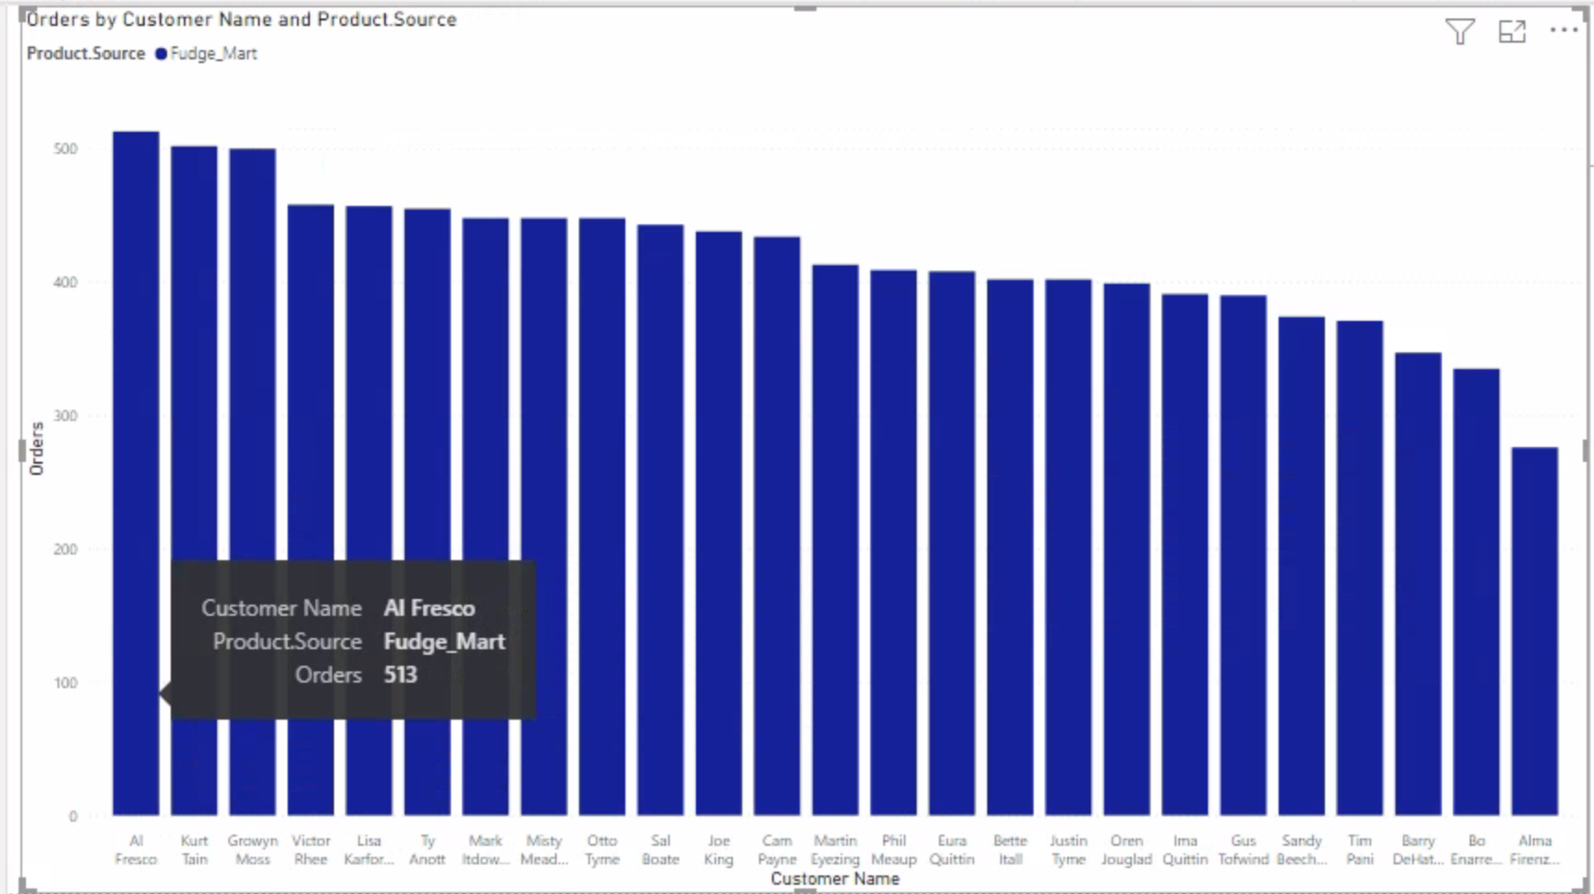
Notes:
Divya

Slide 10
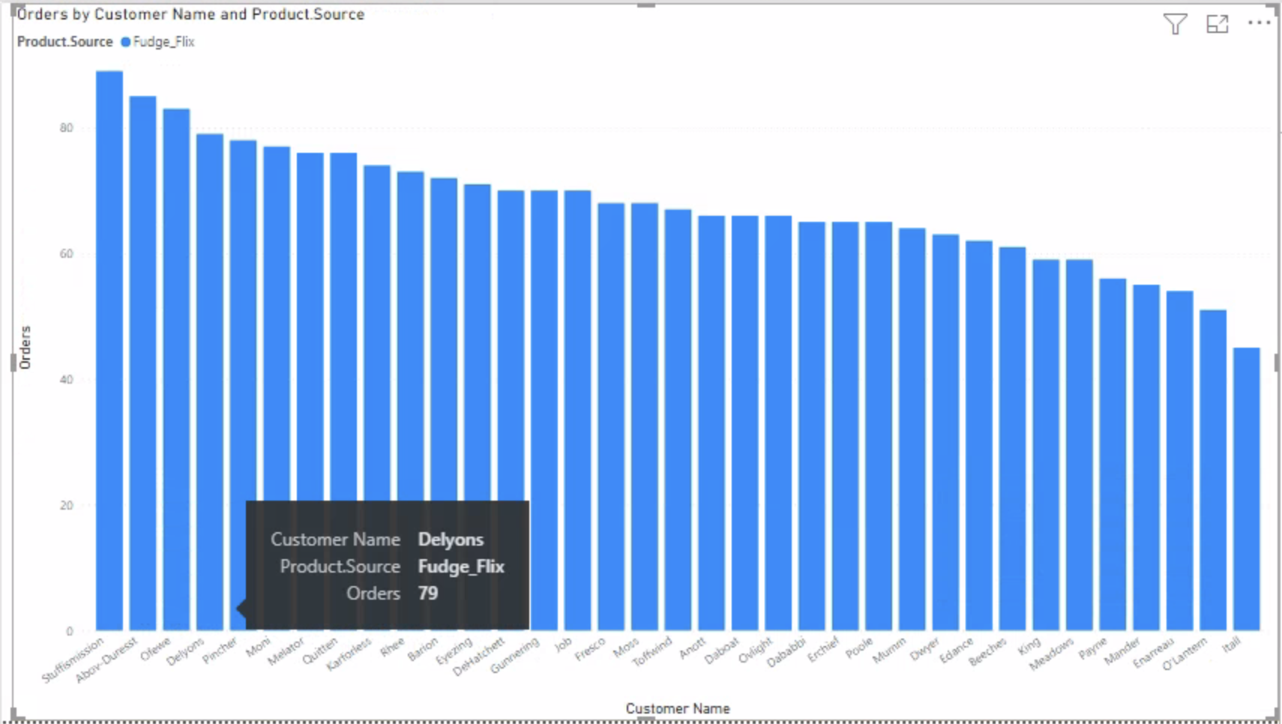
Notes:
Divya

Slide 11
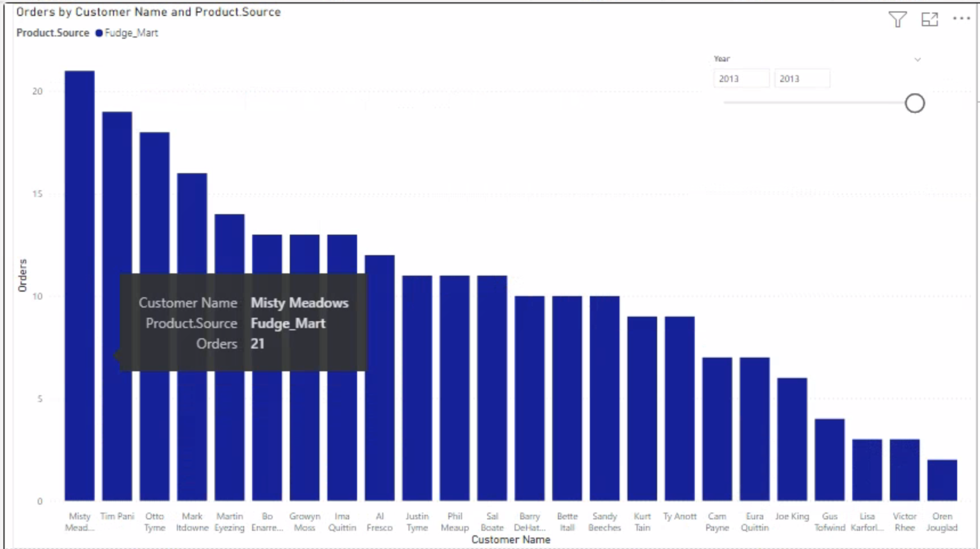
Notes:
Divya

Slide 12
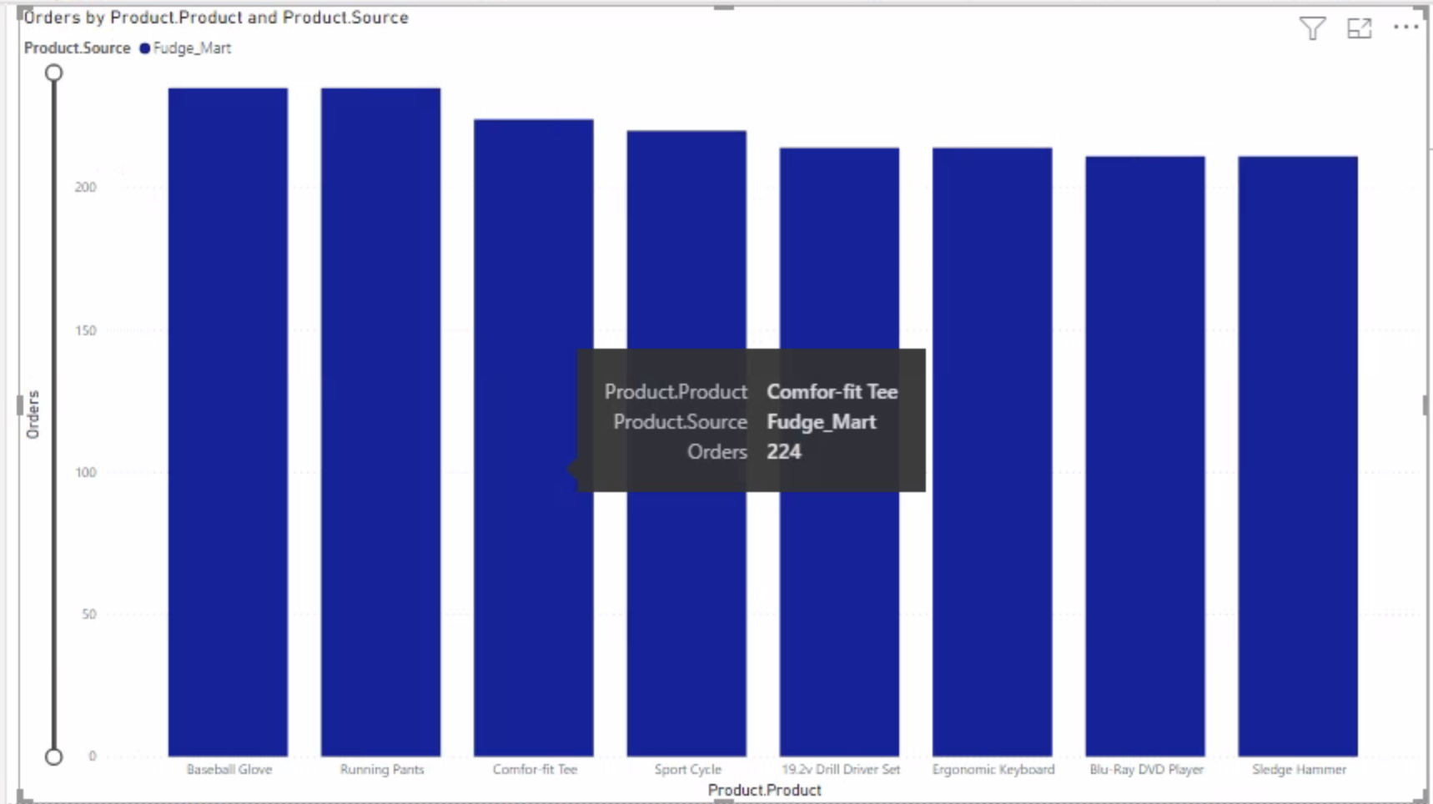
Notes:
Vedant

Slide 13
Recommendations
Add Inventory levels for products to better understand lag time of shipments
Look at which products are getting high lag times to manage inventory
Locations that have less sales can be managed by reduced funding
Frequently returning customers can be given additional discounts to increase customer retention
Cost for products in high demand can be increased
Notes:
Vedant

Slide 14
Thank You!

